Slide 1
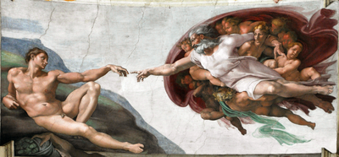
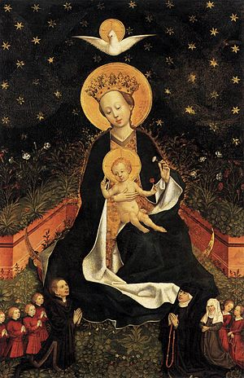
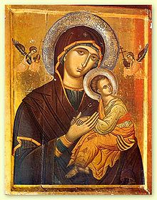
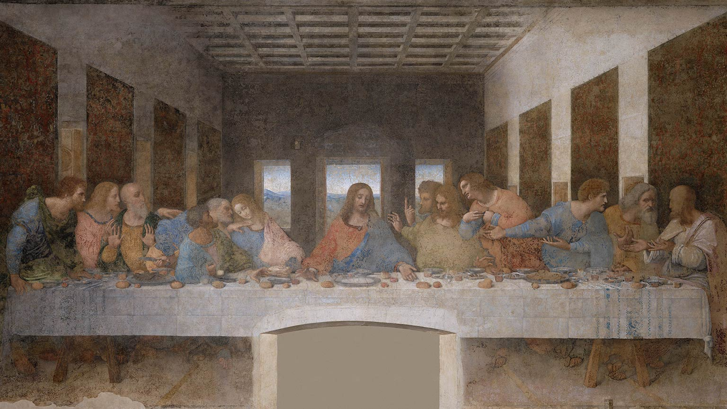
Art of the Byzantine era – Middles Ages
Art of the Italian High Renaissance 1490s – 1520s
Michelangelo, The Creation of Adam (1512)
Our Mother of Perpetual Help - 16th century.
Madonna on a Crescent Moon in Hortus Conclusus is a 1450s painting by an unknown artist
Leonardo da Vinci, The Last Supper (1495)

Slide 2
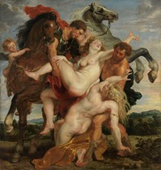
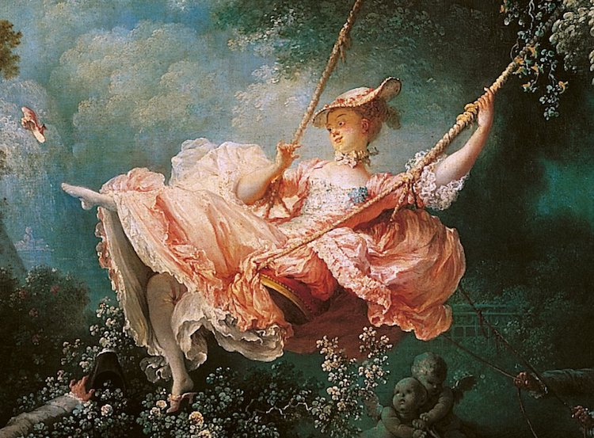
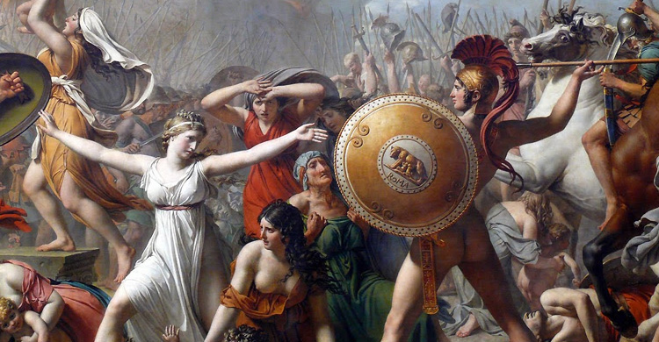
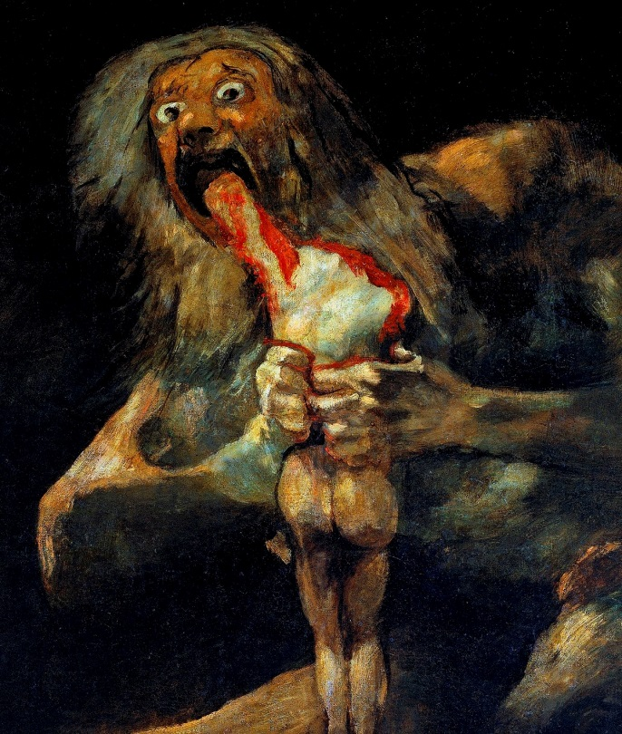
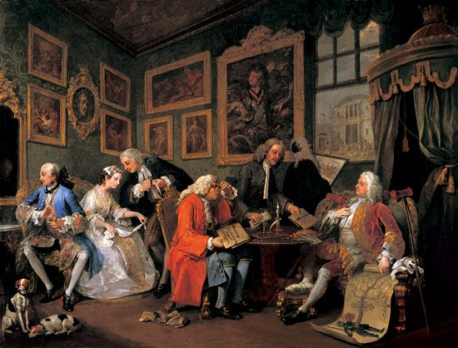
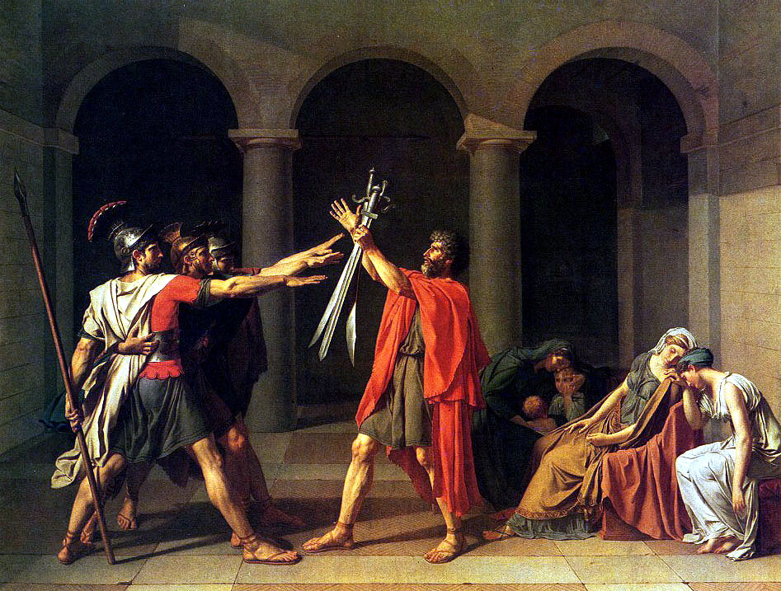
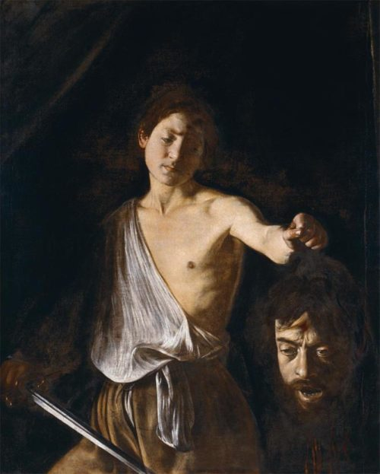
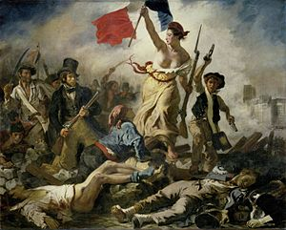
Baroque 1600-1730
Rococo 1720-1780
Neo-Classicism 1750-1830
Romanticism 1790-1880
Jacques-Louis David, The Intervention of the Sabine Women (1799 )
Jean-Honore Frangonard,
The Swing (1767)
Rubens, The Abduction of the Daughters of Leucippus (1618)
Francisco Goya Saturn Devouring His Son (1819)
Caravaggio David with the Head of Goliath (1610)
William Hogarth, Marriage a la Mode (1745)
Jacques-Louis David, Oath of the Horatii (1784)
Eugene Delacroix, Liberty Leading the People (1830)

Slide 3
Criteria for Judging a Piece of Art – esp. as representative of its time
Subject matter: what is depicted, tone, topic, material, scenes, people…
Composition: where things are in the frame, foreground etc, whether it is a triptych or a single painting , focal point and how it is achieved
Medium: gesso, fresco, oil, guache, water-colour etc – (sculpture, and so on…)
Style: brush stroke, line, use of light & shadow, colour, etc
Relationship to reader: how the work is interpreted / meant to be interpreted, who gets to view it?
Production context: who paid for the art? Under what social conditions was the art made? What values / Ideologies of the time influenced the artist?

Slide 4
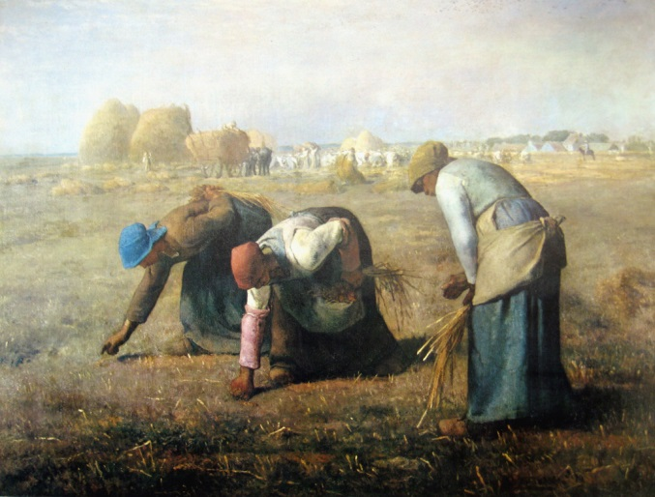
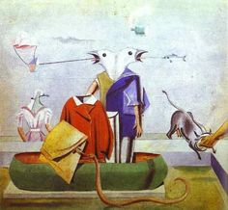
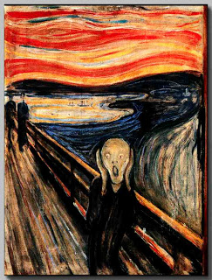
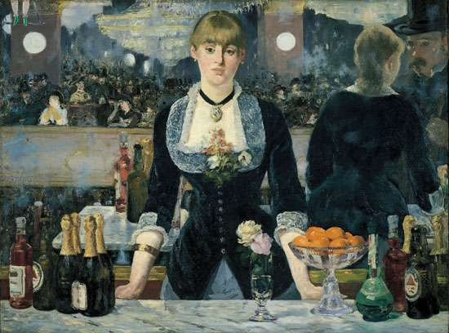
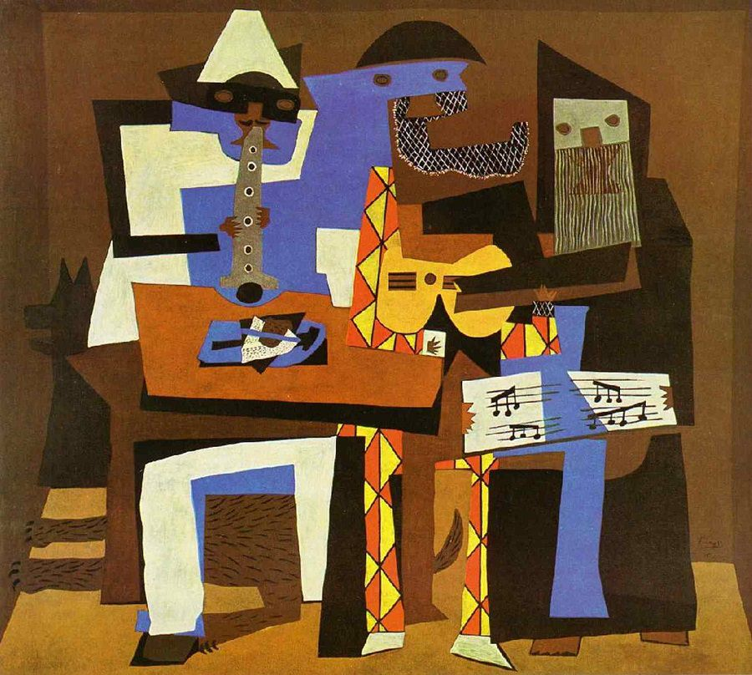
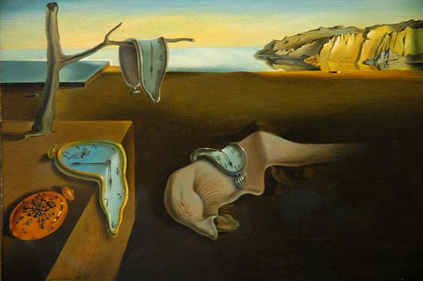
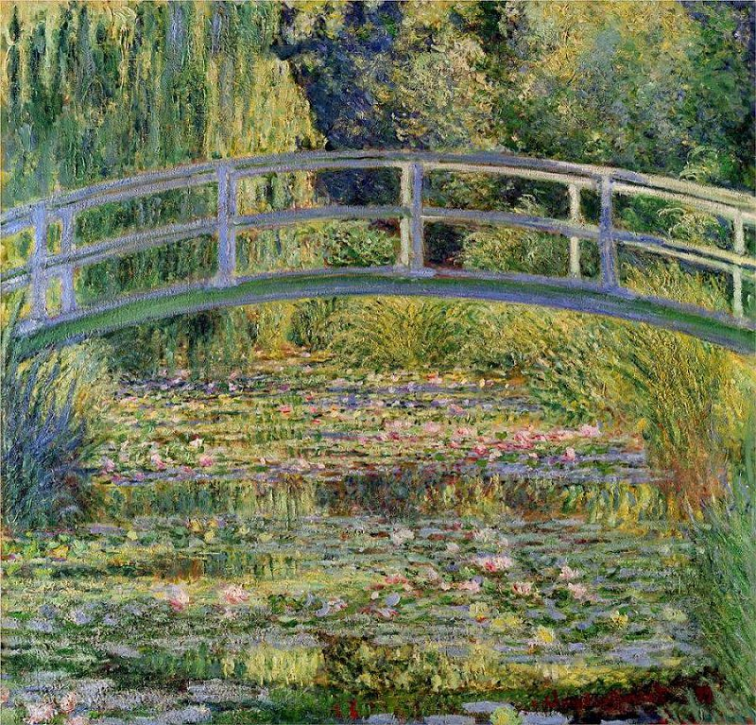
Realism
Art of the Modern era 1860s-1970s
Dada
Jean-François Millet, The Gleaners (1857)
Expressionism
Max Ernst, Birds; also; Birds, Fish-Snake and Scarecrow (1921)
Edvard Munch, The Scream (1893)
Impressionism
Edouard Manet, A Bar at the Folies-Bergère
(1882)
Cubism
Surrealism
Pablo Picasso, The Three Musicians (1921)
Salvador Dali The Persistence of Memory (1931)
Claude Monet, The Waterlily Pond… (1899)

Slide 5
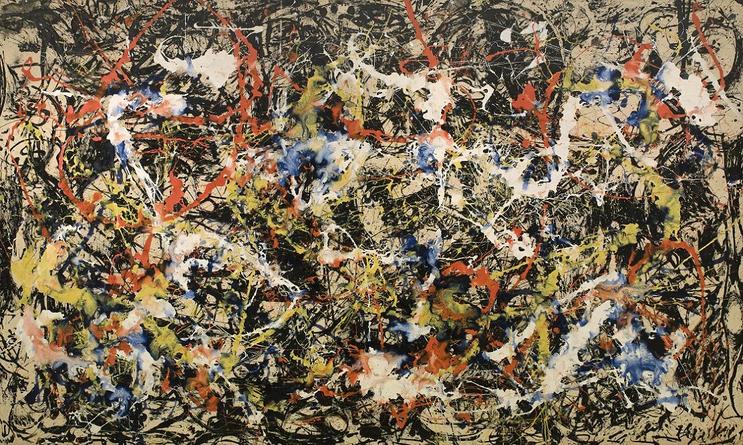
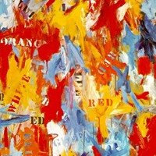
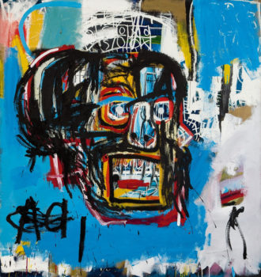
Post-Modern or Contemporary Art - post 1950s
Abstract Expressionism
Neo-Dada
Post-Expressionism
Convergence by Jackson Pollock - 1952
The Untitled by J. M. Basquiat - 1983
False Start by Jasper Johns - 1959

Slide 6
Artistic vs Literary Movement - criteria
In Visual Art
In Literature
Subject matter = what is represented and its iconography
Composition = where things are depicted in relation to one another in the frame & why
Medium = from gesso and fresco to oil on canvas, pencil, water colour etc.
Style = brush stroke, use of light & shadow, colour,
Relationship to reader = from more representational to more impressionistic, more real and external/physical to abstract and internal / emotional
Production context = from hired, commissioned by important people in society for personal homes to art shows / museums and more popular / personal forms of expression
Subject matter = topics, characters, types of situation
Composition = structure and form – ie novel, play, short story, poem and techniques used to structure this such as non-linear plotting, flashback, etc
Medium = literary genre such as fantasy, sci-fi, romance, etc.
Style = author’s own craft and toolbox – how do they use syntax, imagery, symbolism, etc.
Relationship to reader = how do they get readers to engage with the text?
Production context = rise of publishing houses, independent presses, female authors, values and beliefs of the time, world events, etc

Slide 7
Characterizing a Literary Movement
Subject matter
types of topics, characters, situations, messages, issues being dealt with and how (attitude to topics)
Style & Craft
structure and form – ie novel, play, short story, poem and techniques used to structure this such as non-linear plotting, flashback, etc
literary genre such as fantasy, sci-fi, romance, etc.
Literary elements, including narrator
Literary techniques how do they use syntax, imagery, symbolism, etc.
Social Context
Reader = what does the reader have to do to ‘get’ the text? What lenses, values, experiences do they bring?
Writer = what personal and/or world events influenced the production? What was the publishing industry like?
GROUP ACTIVITY: group yourself according to which of the 4 stories you know the best; use the above criteria to try to explain how that story is Modern; use what we discussed in class regarding Modern Art on the earlier slides to focus your ideas. Be prepared to plenary in your ideas.

